Slide 1
KEY LOGGER
Presented By:
1. Poornima P J – Jeppiaar Institute of Technology – Artificial Intelligence and Data Science

Slide 2
OUTLINE
Problem Statement
Proposed System/Solution
System Development Approach
Algorithm & Deployment
Result (Output Image)
Conclusion
Future Scope
References

Slide 3
Problem Statement
Example: In today's digital age, where cybersecurity threats loom large, one of the significant concerns is the proliferation of keyloggers, stealthy software tools designed to monitor and record keystrokes on a user's computer without their knowledge. Keyloggers pose a severe threat to individuals and organizations as they can capture sensitive information such as passwords, credit card details, and other personal data, leading to identity theft, financial loss, and privacy breaches.

Slide 4
Proposed Solution
This solution aims to detect and prevent keyloggers by leveraging machine learning techniques. The process involves data collection, preprocessing, training a machine learning algorithm, deployment of the detection system, and evaluation of its effectiveness.
Data Collection: Gather keyboard input data, including legitimate user patterns and simulated keylogger activities, and label them accordingly.
Data Preprocessing: Clean and normalize the data, splitting it into training, validation, and testing sets.
Machine Learning Algorithm: Train a supervised learning algorithm (e.g., Random Forest, SVM) on the labeled dataset, optimizing hyperparameters and validating the model's performance.
Deployment: Develop a real-time keylogger detection system integrating the trained model, with alert mechanisms to notify users of suspicious activity.
Evaluation: Assess the system's performance using metrics like accuracy, precision, recall, and F1-score, ensuring reliability under various conditions and against different keylogger types.

Slide 5
System Approach
System Requirements:
1.Data Collection Module: Collect keyboard input data and label accurately.
Data Preprocessing Module: Clean, normalize data, and implement feature selection.
Machine Learning Model Training Module: Train algorithms, optimize hyperparameters.
Deployment Module: Develop real-time detection system, integrate with security software.
Alerting and Response Module: Generate alerts, define threat handling protocols.
Evaluation and Monitoring Module: Assess system performance, continuously monitor for threats.
User Interface Module: Create user-friendly interface, provide accessibility features.
Integration and Compatibility: Ensure compatibility, integrate with existing systems.
Libraries Required to Build the Model:
1.Python Libraries: Utilize Scikit-learn, Pandas, NumPy.
2.Other Libraries: Employ TensorFlow or PyTorch, Flask or Django.

Slide 6
Algorithm & Deployment
Algorithm Selection: Utilize Random Forest Classifier for its effectiveness in binary classification tasks and handling complex data relationships.
Data Input: Include keystroke timings, key press durations, combinations, typing speed, rhythm, intervals, system parameters, and user behavior patterns.
Training Process: Train the algorithm on a labeled dataset, preprocess data, split into training/validation sets, optimize hyperparameters via techniques like grid search, and validate using cross-validation.
Prediction Process: Analyze real-time keyboard input for suspicious activity based on deviations from normal behavior, anomalous patterns, and known keylogger signatures.
Deployment: Deploy as a real-time monitoring tool integrated into the OS or standalone application, triggering alerts upon detection of suspicious activity for timely response and maintenance of robust protection.

Slide 7
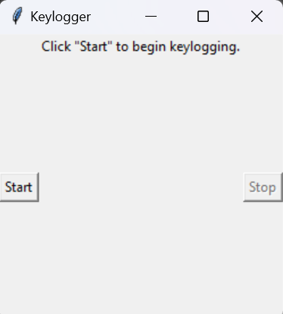
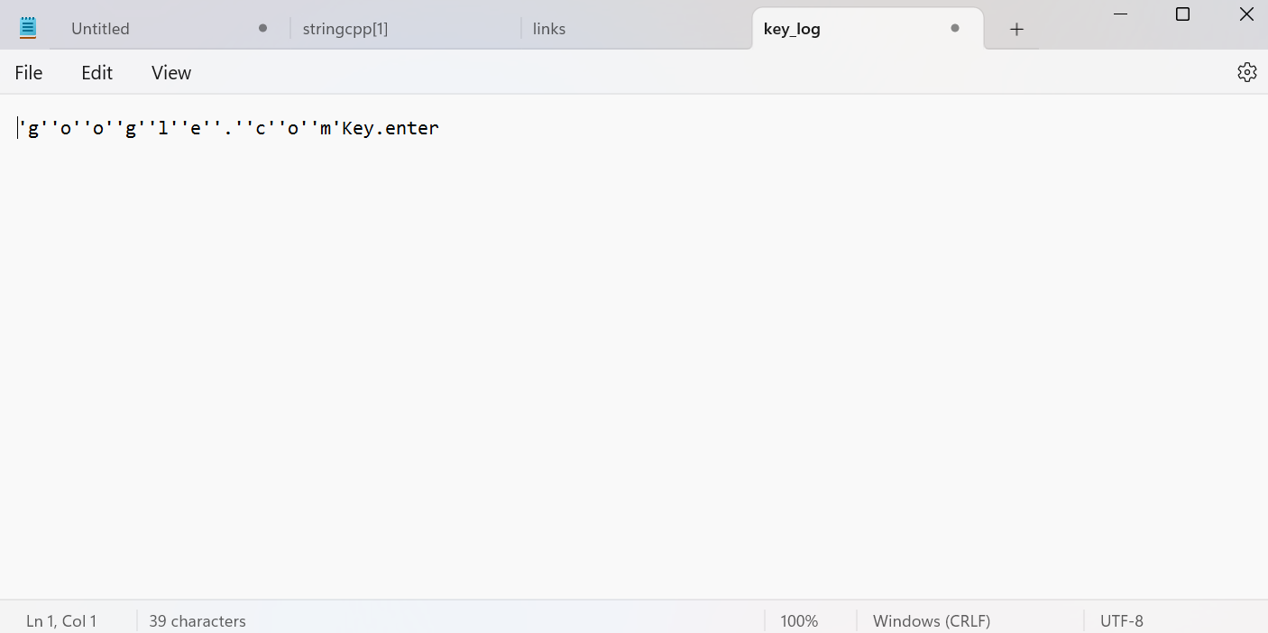
Result

Slide 8
Conclusion
In summary, the keylogger detection system represents a crucial tool in bolstering cybersecurity. Through the use of machine learning algorithms and real-time monitoring, it effectively identifies and mitigates the threat of keyloggers, safeguarding sensitive information from unauthorized access. Continuous vigilance, adaptation, and user awareness are essential to maintain its effectiveness in the face of evolving cyber threats. By prioritizing cybersecurity and investing in robust defense measures, we can create a safer digital environment for individuals and organizations alike.

Slide 9
Future scope
Advanced Machine Learning: Explore deep learning models like CNNs or RNNs for better accuracy.
Behavioral Analysis: Improve techniques for distinguishing legitimate and malicious behavior.
Real-Time Response: Develop automated mitigation and dynamic adaptation to new threats.
Cloud Integration: Use cloud-based deployment for scalability and centralized monitoring.
User-Centric Features: Provide user-friendly interfaces and educational resources for cybersecurity awareness.
Collaborative Research: Partner with cybersecurity experts for insights into emerging threats.
Threat Intelligence: Integrate feeds for better detection of known keylogger signatures.
Privacy Preservation: Implement measures for secure handling of user data and compliance.

Slide 10
References
Anti-virus software: Many reputable antivirus programs include built-in features to detect and remove keyloggers alongside other malware threats https://home.sophos.com/en-us/security-news/2019/what-is-a-keylogger.
System monitoring tools: These tools can help identify suspicious processes or programs that might be keyloggers by monitoring your computer's activity https://www.makeuseof.com/how-to-detect-remove-keyloggers/. Task Manager on Windows and Activity Monitor on Mac are two examples.
Behavioral detection: Advanced security solutions can use behavioral analysis to identify programs that exhibit suspicious behavior, which can be a sign of a keylogger https://home.sophos.com/en-us/content/best-keylogger-removal.

Slide 11
THANK YOU

